Slide 1


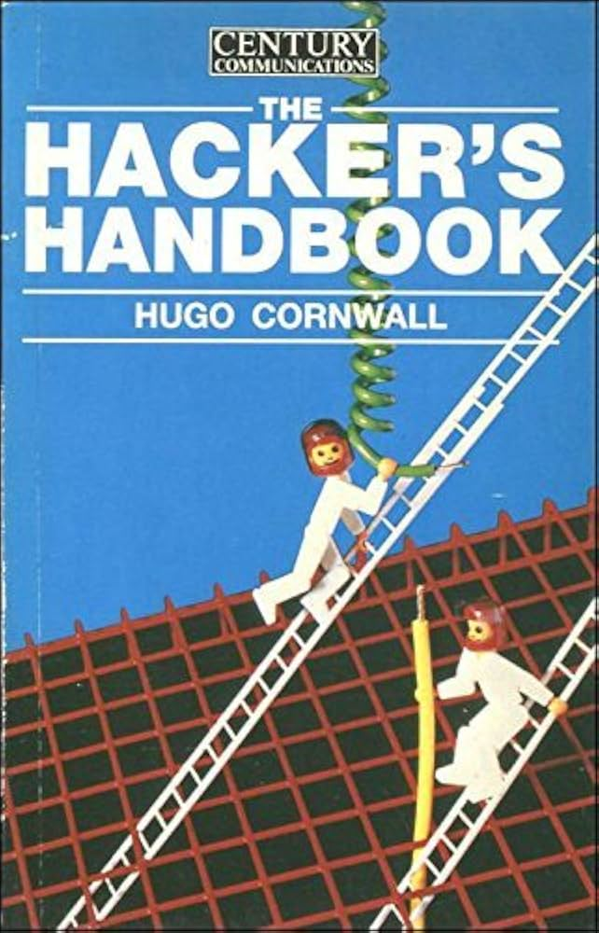
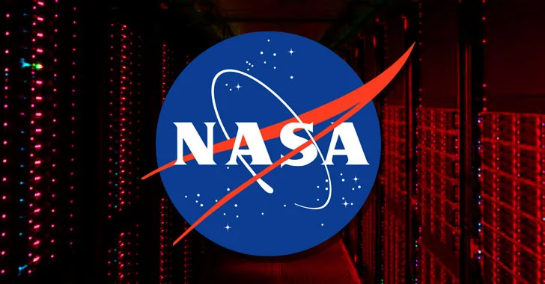
Solo: United Kingdom’s Infamous Hacker Of Nasa!
Who Is Gary McKinnon? Gary is a resident of North London, who is most famously known for his successful cyber attacks on the United States. Gary has always been a computer head and has been always interested in UFOs. Through Gary’s knowledge for computers and efforts to learn more, he took a risk to hack into the United States militaries systems as well as NASA’s. McKinnon found great success in this and almost went undetectable by U.S. officials.
Court Process:
McKinnon was arrested in 2002 by the British police after the US traced the NASA hacking back to his personal computer. The US wanted to extradite McKinnon under the 2003 U.S. UK extradition treaty and if he was found guilty in the US he could face up to 70 years in prison. 2005-2010 McKinnon fought the extradite stating that he should be tried in the UK where he is from instead of the United states. His appeal was denied by the high courts in 2006 and then denied again in 2008 by the House of lords. McKinnon then tried for a 3rd time but was denied again by the European Court of Human Rights in 2009.
Later on, during the trial He was diagnosed with Asperger’s syndrome which is a type of autism spectrum disorder. After many medical evaluations it was decided that extraditing McKinnon could harm his mental health severely. In 2012 Home Secretary Theresa May decided to block the extradite due to human rights concerns using article 3 of the human rights convention. She argued that extraditing him would pose a serious risk of inhumane or degrading treatment. The Britain government than announced that McKinnon would not face charges in the UK due to insufficient evidence.
m
What Gary Found:
Gary’s attack started in February of 2021 and lasted only a year. In March of 2002 Gary stated that under the folder titled “unfiltered”, there were ”regularly airbrushed out images of UFOs from the high-resolution satellite imaging. Gary also figured out how to access these files and systems remotely. Being so intrigued and pleased with what he found, he kept going, finding an Excel spreadsheet that “contained names and ranks of the US Air Force personal not registered anywhere else” (Non-Terrestrial Officers). The final piece that capped off McKinnon’s hacking spree was the file that had information on “ship-to-ship transfers”, which were not connected to the government.
Tactics Gary Used: Since 1990 Gary was convinced to get a qualification in computers. Gary’s friends pushed him to complete courses, ultimately putting him in the computing field. Knowledge built up from his courses flipped a switch in to “research his belief the US government was withholding critical information about UFOs”. Gary quickly realized that the U.S. government uses Windows as their primary operating system. Gary mentions “The Hacker’s Handbook” by Hugo Carnwall kicked started his hacking abilities, tagging along side with the internet. McKinnon kept on reading news articles and widespread information about inventions that aligned with his goals.
The Cost :The estimate coast for all the racking was 700k and this was a very huge deal. Gary McKinnon wasn't being honest about his actions, and it was very serious. According to theguardian.com, "McKinnon, from north London, was accused in 2002 of using his home computer to hack into 97 American military and Nasa computers, causing damage that the US government claims will cost more than $700,000 (£425,000) to repair." This shows how much of a serious situation this was.
Notes:
BBC. (2012, December 14). Profile: Gary McKinnon. BBC News. https://www.bbc.com/news/uk-19946902
Guardian News and Media. (2009, December 10). Gary McKinnon challenges extradition. The Guardian. https://www.theguardian.com/world/2009/dec/10/gary-mckinnon-lodges-challenge-extradition#:~:text=After%20the%20home%20secretary’s%20decision
The hacker who breached NASA to prove that ufos exist | Cybernews. (n.d.). https://cybernews.com/tech/hacker-who-breached-nasa-trying-prove-ufo-existence/
Podcast, M. L. (n.d.). Malicious life podcast: The U.S. vs. Gary McKinnon. Cybersecurity Software. https://www.cybereason.com/blog/malicious-life-podcast-the-u.s-vs.-gary-mckinnon#:~:text=He%20agreed%20to%20be%20evaluated,the%20classic%20patterns%20of%20Asperger’s

